Slide 1


Security, Integrity, and Trust in HPC Artificial Intelligence
CLSAC 2023 - Security of the Analytic, by the Analytic and for the Analytic
Notes:
POINT OF CONTACT:
Arun Majumdar
Tel: 571-344-0521

Slide 2
Bits / Electron → Future Devices ➔ Bigger, Better, Faster Analytics
Notes:
http://www.quora.com/How-many-atoms-are-used-by-current-storage-devices-to-store-one-bit-of-information
http://www.ibm.com/smarterplanet/us/en/smarter_computing/article/atomic_scale_memory.html
September 1956, IBM 305 RAMAC –5 MB/gram
Therefore, Fe2O3 160 gram/mol so use Avogadro’s constant to compute bit – about 10^23 atoms is
Cost corrected for 2015 = $1,401,862.68/gram for about 1 grams of material total on 50 drum-plates
So Electrons is 5 for Fe2O3 (approx – should be 7 but averaging for materials variances)

Slide 3


Slide 4
Assumption
Modern Analytics needs AI

Slide 5

Analytics: Data at Rest, Data in Transit, Data in Use
ANALYTICS
Data Poisoning
Data
Corruption
Fake
Data
Data at Rest
Data in Transit
Data in Use

Slide 6
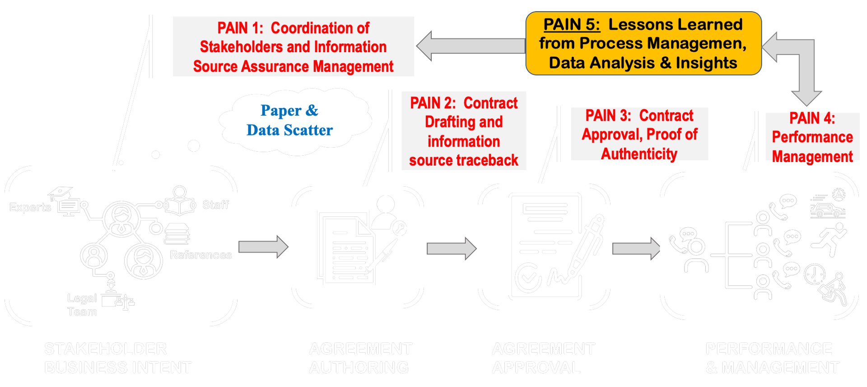
Example of a Legal Process – Risks from the Processes

Slide 7
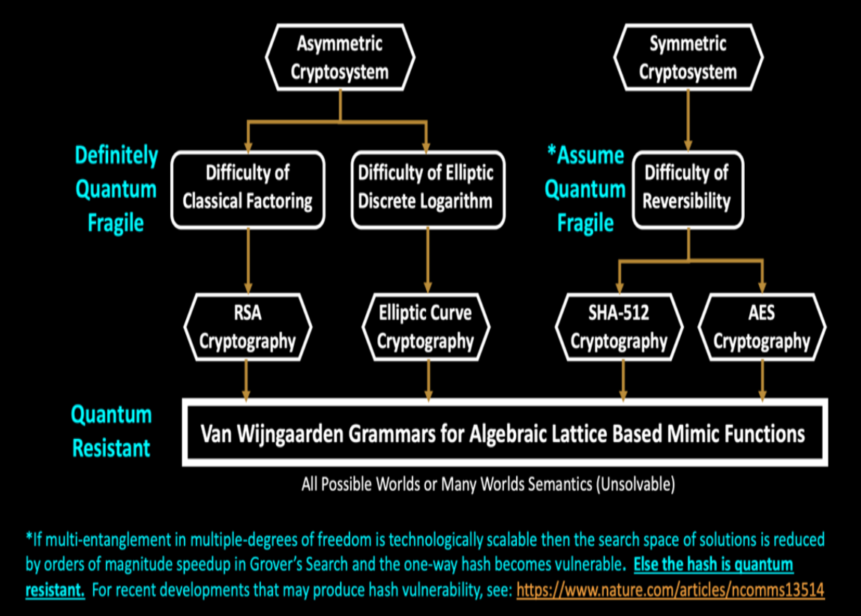
Security of Data at Rest, In Motion and In Use – Risks in Confidentiality
Is there One Ring To Rule them All?

Slide 8
Supply Chain – Multi-Source – Risks in Integrity
Missile Drones flew from Yemen and hit the refinery
NEWS PAYOUT BOARD
DATA SUPPLY CHAIN
CONSUMERS
Sa: 75
Jr: 10
Ab: 90
100% DATA INTEGRITY
Salman
News – Consensus = %80
Aggregator
Pay $3
DRONE
ATTACK
ON OIL
REFINERY
EVENTS AT
OIL
REFINERY
DATA
Jafar
News – Consensus = %50
Pay $1
Verification and Validation
Abdul
News – Consensus = %90
HOW TO MITIGATE D5 CYBER-ATTACKS?
Pay $4
CBC, CNN
People set fire
To the refinery
PAYMENTS
News Stringers
Houthi Rebels Fired Drones at the refinery
DATA POISONING (FAKE NEWS) DETECTION?

Slide 9


AI is Revolutionizing Analytics, but . . .
But tools such as ChatGPT threaten transparent science; here are our ground rules for their use – “Nature”
GPT and LLMs (Large Language Models) Fabricate Information – “American Chemical Society” (ChatGPT and Environmental Research)
untrustworthy, insecure and impractical
Notes:
Because of our deep expertise in the field, we realized several years ago that AI was about to takeoff
A rapid growth of companies would want to capitalize on the ai wave with one-off products
It has gotten crowded and quite frothy

Slide 10
Three Representative Cases
SECURITY:
These are of course all interconnected
01
Privacy
Security of the Analytic
DoD/IC
The analytic model is corrupted, causing false positives, false negatives, spills and leaks.
02
Integrity
Corporates
Security by the Analytic
03
Misclassifying data samples, failure to verify facts. Countering-hallucinations and confabulations.
Measurability
HR & Banking
04
Confidence
Security for the Analytic
Loss of integrity in parts of the data causing error in results,
Lack of transparence, command and control, Automation Surprise
05
Trust
Notes:
Here are some critical representative cases of

Slide 11
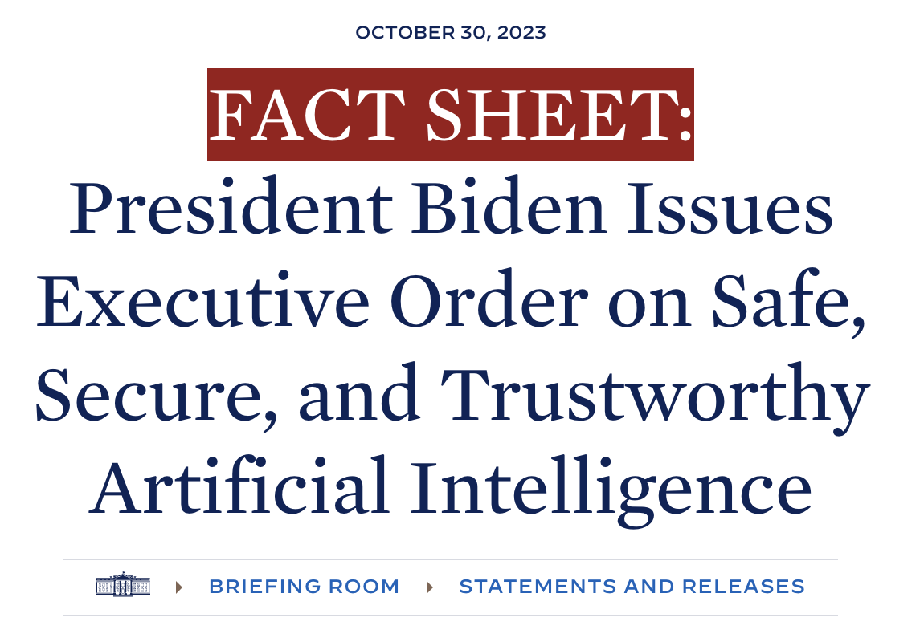
Safe, Secure & Trustworthy AI
SECURITY:
01
Privacy
02
Integrity
03
Measurability
04
Confidence
05
Trust
https://www.whitehouse.gov/briefing-room/statements-releases/2023/10/30/fact-sheet-president-biden-issues-executive-order-on-safe-secure-and-trustworthy-artificial-intelligence
Notes:
Safety – Security – Trust.

Slide 12
What’s in the new Executive Order?
Ensure developers of AI , especially of dual-use foundation models , to conduct AI red- teaming tests to enable deployment of safe , secure , and trustworthy systems .
Create robust , reliable , repeatable , and standardized evaluations of AI to provide measurably secure systems.
Provide mechanisms to test , understand , and mitigate risks from these systems before they are put to use.
Ensure compliance with record-keeping , cybersecurity , confidentiality , privacy , and data protection requirements
Develop model guardrails and protect the integrity and trustworthiness models.
Install differential-privacy safeguards and prohibit leaks, spills and exposure of PII.
Secretary of Commerce , via the Director of NIST, with the Director of OMB and the Director of OSTP , shall develop guidelines , tools , and practices to implement Artificial Intelligence risk-management.

Slide 13
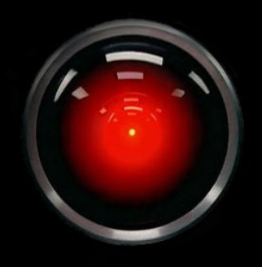
Security of the Analytic, by the Analytic and for the Analytic
HAL, please open the door, for my pod … HAL, please open the door.
I’m sorry Dave, I can't open the door
Notes:
Security, Integrity, Trust

Slide 14
Probabilistic Computing
In a probabilistic computing, the heavy lifting is done by an inference rule—the algorithm that readjusts probabilities on the basis of new training data – cannot abstract to unknowns

Slide 15
Quantum Information
In Quantum information, the heavy lifting is done by transition-functions — models for movement over probabilistic state representations on the basis of new distributions of outcomes given data inputs – can abstract to unknowns

Slide 16
Large language models (LLM)
Combine the aspects of both classical Probability models and Quantum models, the heavy lifting is done by tensorial network interactions— models transforming between distributions of activations and given data inputs and outputs – expresses emergent behaviors not originally designed
The underlying tensorial structure resembles the quantum many-body wave function - hence LLMs/GPT possess quantum-like properties!

Slide 17
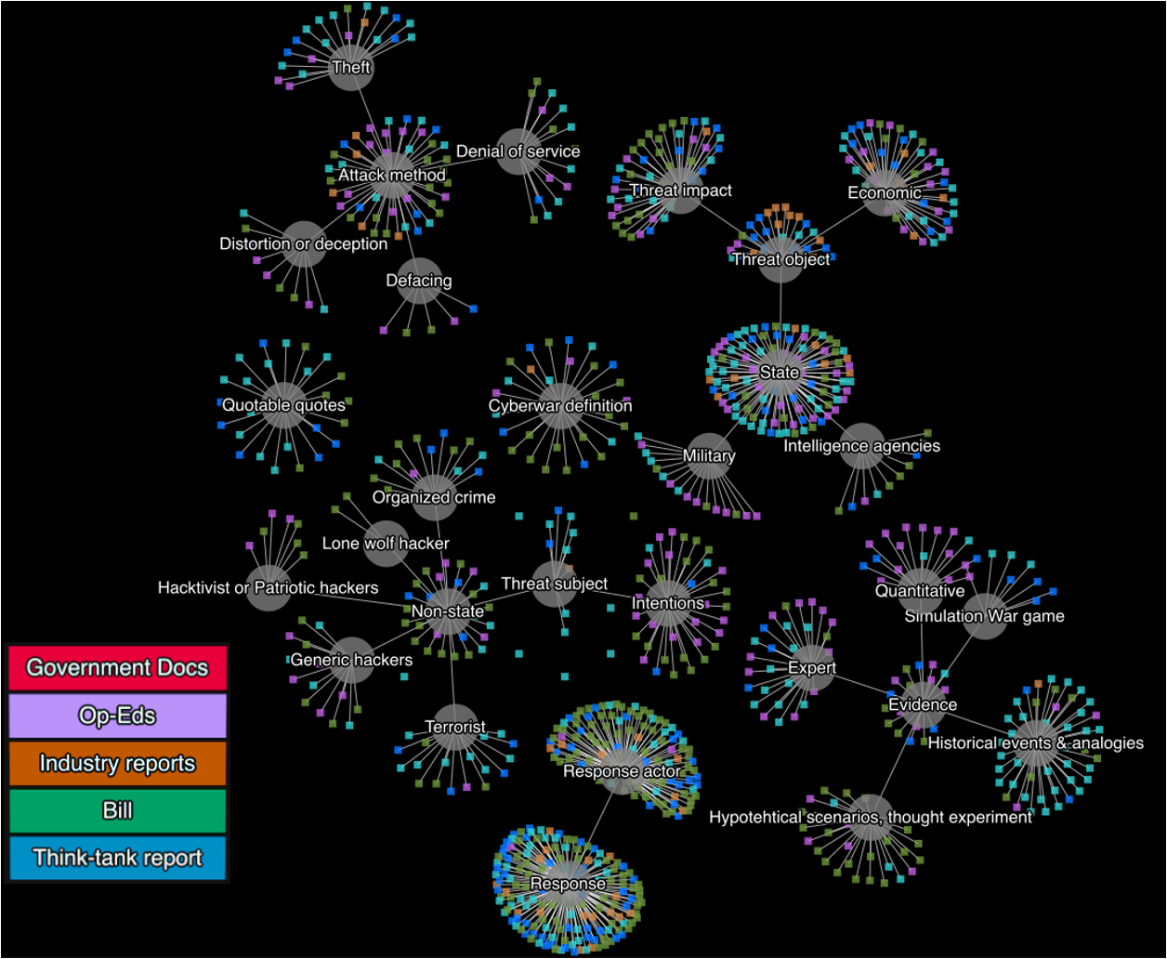
CYBERSPACE
. . . AND MANY OTHER SOURCES AND COLLECTIONS

Slide 18

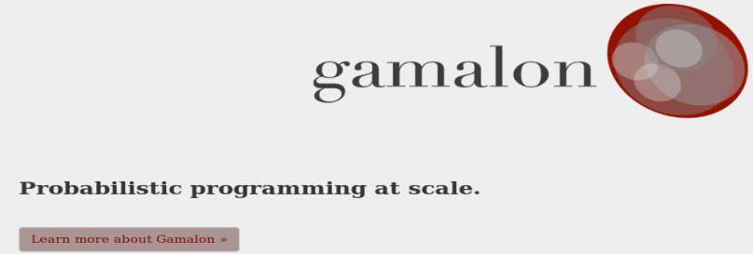
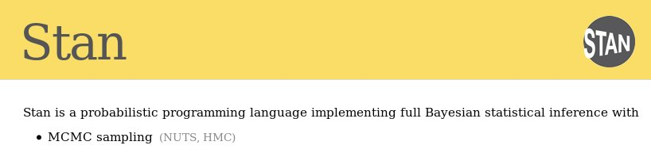

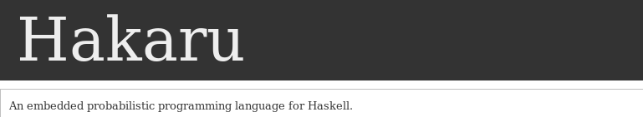
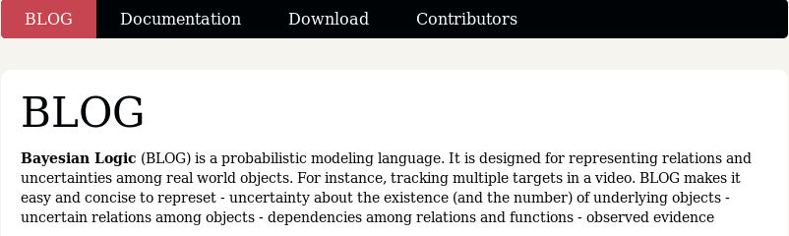
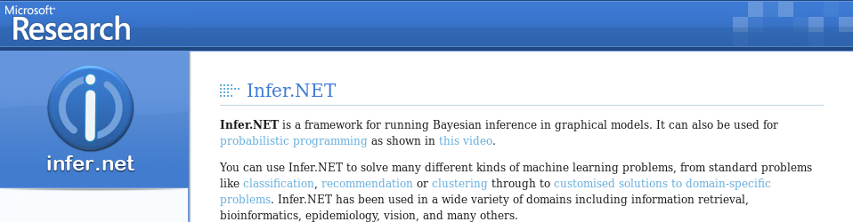

Probabilistic Programming

Slide 19
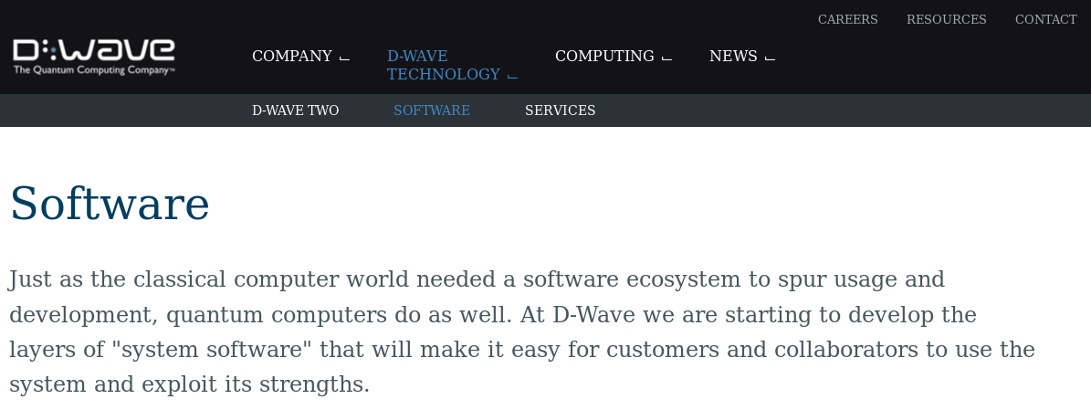
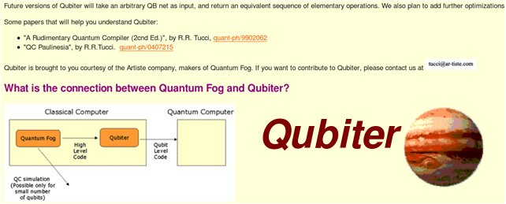
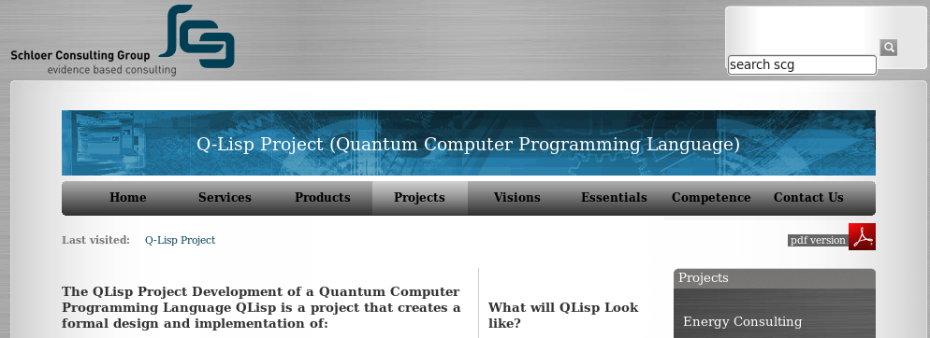

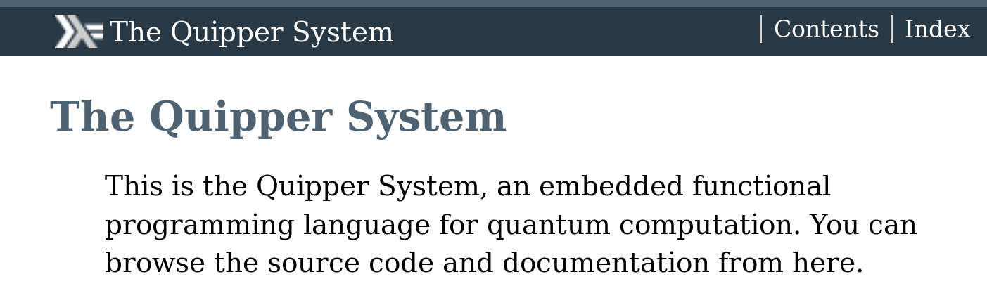
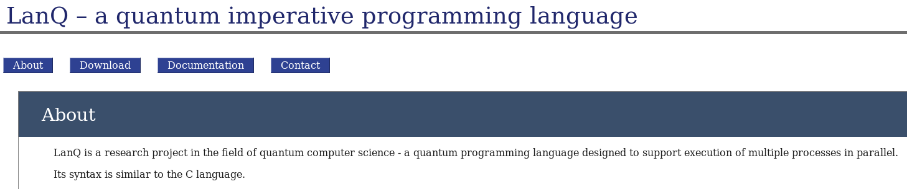
Quantum Programming

Slide 20

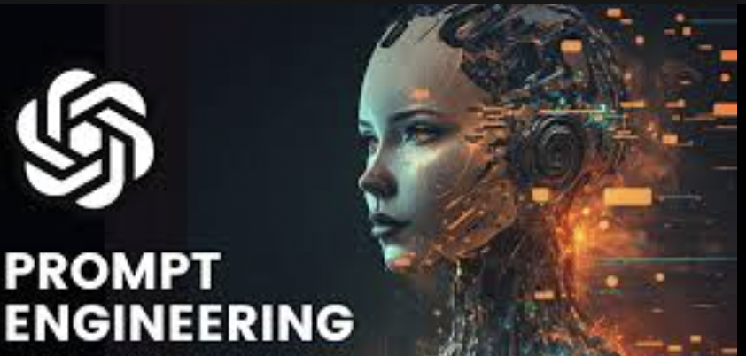
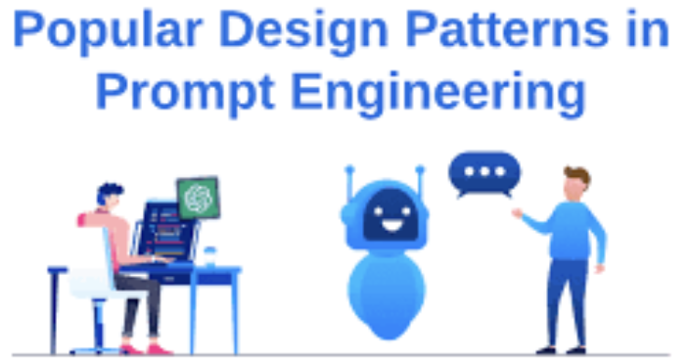
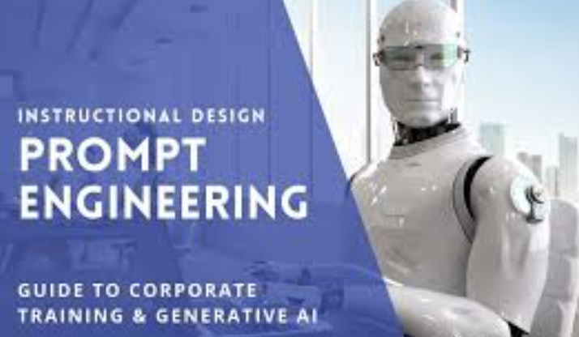

Prompt Design or Engineering?

Slide 21




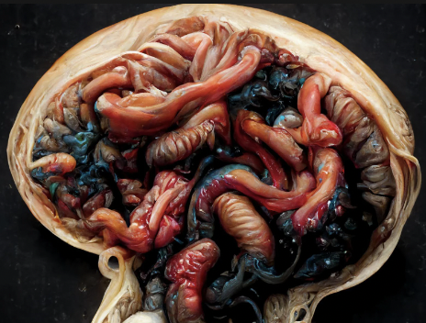
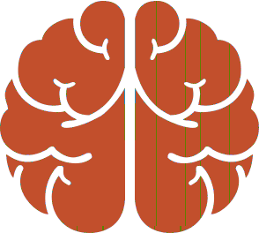

Autonomic AI Poisoning
MACHINE GENERATED CONTENT
HUMAN GENERATED CONTENT
POWERFUL MODELS & SOLUTIONS
FAKES
CONFUSIONS
BREAKDOWNS
GPT
Probability Distributions of Original Content Disappear
LLM AI GENERATED CONTENT
MODEL COLLAPSE
DEGENERATION
BIAS
THROW AWAY
DIGITAL CONFABULATIONS
INSTRUCTION TUNING
PROMPT-ENGINEERING

Slide 22

TODAY’s LEGACY
348 days
average time before a 0-day is public knowledge
Vulnerabilities will always exist.

Slide 23
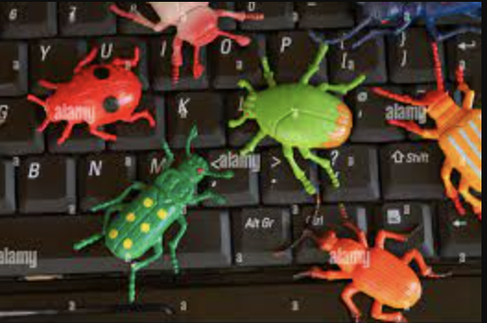
TODAY’s LEGACY
100,000+
new malware samples per day
Signature-based detection is dying.
Threat TTPs are dynamic and will change.

Slide 24

TODAY’s LEGACY
60 months
PLA Unit 61398 maintained APT access to US Orgs
Response is predicated on detection…
What do you do if you can not detect?

Slide 25
What do we need?

Slide 26
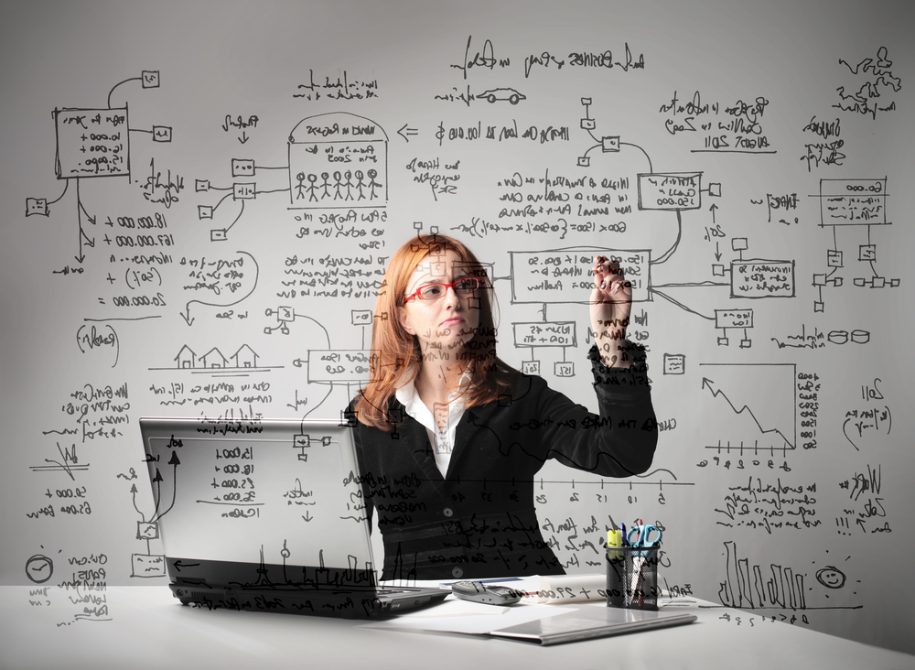
POLICY AUTOMATION
ATTESTATION
VERIFICATION
VALIDATION
PROOF
Trusted Human-like analysis

Slide 27
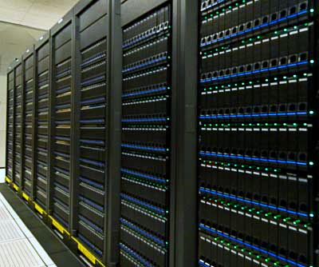
PERFORMANCE
MULTI-MODEL
DIVERSITY
PARALLELISM
SUSTAINABILITY
Supercomputer-like performance

Slide 28

BLOCKCHAIN
CONFIDENTIALITY
INTEGRITY
AVAILABILITY
COMPUTABILITY
Data Agnostic

Slide 29
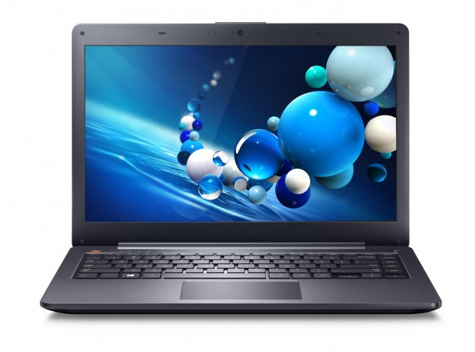
PORTABILITY
RESILIENCE
TRUSTED DEVICES
SUPPLY CHAINS
MANUFACTURING
Small Footprint (↓SWAP)

Slide 30
Risks in Artificial Intelligence
Deception, hacked Machine Learning, poisoned Artificial Intelligence model and Deep Fakes
is the data which is used to make decisions trustworthy?
Has this data been poisoned?
Is the data that is at the source of machine learning for decision making being corrupted en-route?
Emergent Threshold of Complexity:
Use the “force”
Flip to the “Dark Side”

Slide 31
Thank You!

